Slide 1

PYTHON
Module 2:Beginning Python Basics
PRESENTATION BY: GOPINATH.G

Slide 2
Python syntax
What is syntax ?
Python syntax refers to the set of rules that dictate how Python programs should be written. It defines the correct combinations of symbols, keywords, and other elements to create valid Python programs.
Indentation
Variables
Data types
Comments
Control flow statements
Loops
Functions
classes

Slide 3
Python Indentation
Indentation refers to the spaces at the beginning of a code line.
In other programming languages the indentation in code is for readability only, the indentation in Python is very important.
Python uses indentation to indicate a block of code.
Indentation example

Slide 4
Python Variables
Variables are containers for storing data values.
Creating Variables
Python has no command for declaring a variable.
A variable is created the moment you first assign a value to it.
Variables example

Slide 5
Python comments
A comment is a programmer-readable explanation or annotation in the source code of a computer program. They are added with the purpose of making the source code easier for humans to understand, and are generally ignored by compilers and interpreters.
Python has commenting capability for the purpose of in-code documentation.
Comments start with a #, and Python will render the rest of the line as a comment:
Comments example

Slide 6
Multiline Comments
Python does not really have a syntax for multiline comments.
To add a multiline comment you could insert a # for each line
shortcut alt+f3 to make selected line comment.
Shortcut alt+f4 to remove selected line comment.
Python will ignore string literals that are not assigned to a variable, you can add a multiline string (triple quotes) in your code, and place your comment inside it.
Multiline comment example

Slide 7
Python Variables (detailed)
Variables of two types:
1. Local variable
2. Global Variable
Casting
If you want to specify the data type of a variable, this can be done with casting.
Example for Casting

Slide 8
Variable Names
A variable can have a short name (like x and y) or a more descriptive name (age, carname, total_volume). Rules for Python variables:A variable name must start with a letter or the underscore character.
A variable name cannot start with a number.
A variable name can only contain alpha-numeric characters and underscores (A-z, 0-9, and _ ).
Variable names are case-sensitive (age, Age and AGE are three different variables).
A variable name cannot be any of the python keywords.
Variable names examples

Slide 9
Multi words Variables
Variables with one or more word is difficult to read and assign
It is possible with basic cases
Camel case: Each word, except the first, starts with a capital letter
Pascal case: Each word starts with a capital letter
Snake case: Each word is separated by an underscore character
Examples for the following cases

Slide 10
Assigning more then one value
More then one variable for single value
Example
multiple values to single variables
Example

Slide 11
Output Variables
The Python print() function is often used to output variables.
Example for Output variable

Slide 12
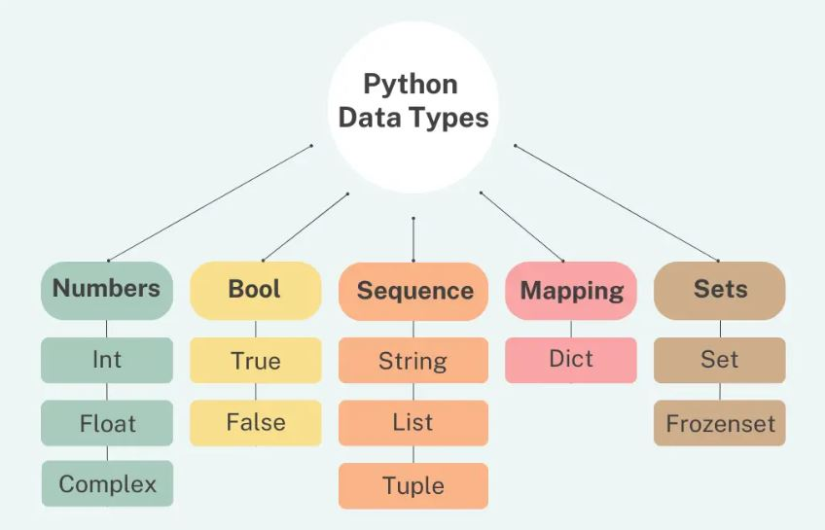
Python Data Types
Built-in Data Types
Variables can store data of different types, and different types can do different things.
data types built-in by default
Text Type: str
Numeric Types: int, float, complex
Sequence Types: list, tuple, range
Mapping Type: dict
Set Types: set, frozenset
Boolean Type: bool
Examples for each data type

Slide 13
Getting the Data Type
You can get the data type of any object by using the type() function
Example for type()

Slide 14
Random Number
Python has a built-in module called random that can be used to make random numbers
Example for Random

Slide 15
THANKYOU..!

